Slide 1
BIOLOGY SEMINAR QUESTIONS
BY
SEGGANE FRANK RICHARD

Slide 2
NO. 1
(a) Distinguish between a seed and a fruit.
(b) Giving one example in case, describe how simple true fruits are classified into different types.

Slide 3
NO.2 An experiment was carried out to determine the volume of water that was drained through each of soil sample X and Y at different time intervals. The results obtained are shown in the table below. Study the data carefully and answer the questions that follow.
Time in seconds | Volume of water drained through soil sample in cm³
 | X | Y
10 | 4 | 8
20 | 7 | 13
30 | 9 | 18
40 | 11 | 24
50 | 12 | 33
60 | 12 | 40
70 | 12 | 42
80 | 12 | 42

Slide 4
NO. 2
Using the same axis, plot a suitable graph to represent the above data.
From the graph, state differences in drainage in the two soil samples.
Explain the differences in the rate drainage stated in (b) above.
Calculate the rate of drainage at 40 seconds for each soil sample.
(i) if 100m³ of water was added to each soil sample, calculate the amount of water retained by each soil sample X and Y.
(ii) Explain the significance of your results in (c) (i) above to the farmer.

Slide 5
NO. 3
Explain why a transport system is necessary in complex organisms.
Explain why microorganisms do not need a transport system.
State four differences between blood and lymph
State the adaptations of the following to their respective transport functions:
(i) . Xylem (ii) Artery

Slide 6
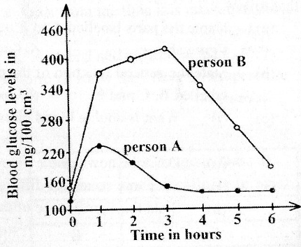
NO. 4
In an investigation, two persons A and B drank the same amount of glucose solution. Their blood sugar levels were determined immediately and thereafter at intervals of one hour for the next six hours. The results obtained are shown on the graphs below.

Slide 7
NO. 4
Describe the trends of the graph:
For person A
For person B
Give reasons for the trends of blood glucose levels in person A between:
0 and 1 hour
1 and 4 hours
Suggest a reason for the high glucose level in person B.
What is the biological importance maintaining a relatively constant sugar level in human body?

Slide 8
No. 5 The table below shows the oxygen consumed by an athlete and concentration of lactic acid in the blood of the athlete during and after a vigorous exercise. The exercise lasted for the first 25 minutes.
Time (minutes) | Oxygen consumption (dm^{3 /} minute) | Lactic acid concentration (mg/10cm³ blood)
0 | 0.2 | 2.0
10 | 3.0 | 5.2
20 | 3.0 | 8.2
25 | 3.0 | 9.8
30 | 1.0 | 8.0
40 | 0.4 | 5.0
50 | 0.2 | 2.8

Slide 9
NO. 5
On the same axis, represent the data in the table above on the graph.
Describe the athlete’s oxygen consumption during and after the race.
During the race (ii) After the race
c) Explain why the oxygen consumption:
(i). Increases during exercise?
(ii) Does not return immediately to the resting level after the exercise is finished?

Slide 10
NO. 6 The table below shows the effect of applying different concentrations of auxins to the shoots and roots of cereal seedlings.
Auxins concentration (ppm) |  | 10⁻⁶ | 10⁻³ | 10⁻⁴ | 10 | 10 | 10 | 1 | 10 | 100
Elongation relative to control (mm) | Shoot | 0 | 0 | +1 | +4 | +8 | +36 | +60 | +32 | -24
 | Root | +2 | +4 | +12 | +8 | -2 | -24 | -40 | -40 | -40
On the same axis, represent the data in the table above on a suitable graph.
State the differences between the elongation in shoots and elongation in roots in relation to auxins concentration.
Account for the differences in elongation in shoots and in roots between:
10⁻⁶ and 10⁻⁴ Auxins concentration
10⁻² and 1 Auxins concentration
Outline two practical applications of auxins in Agriculture.

Slide 11
NO. 7
Distinguish between;
Movement and locomotion
Endoskeleton and exoskeleton
Describe how the following structures are adapted to their functions;
Axis vertebra in mammals
Quill feathers in birds

Slide 12
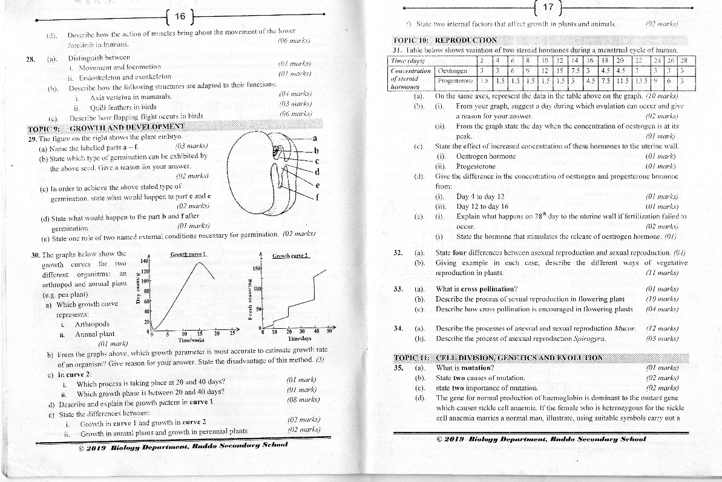
NO.8 The graphs below show the growth curves for two different organisms: an arthropod and annual plant (e.g pea plant).

Slide 13
NO. 8
Which growth curve represents:
arthropods
annual plant.
b) From the graphs above, which growth parameter is most accurate to estimate growth rate of an organism? Give reason for your answer. State the disadvantages of this method (3)

Slide 14
NO. 8
c) In curve 2:
which process is taking place at 20 and 40 days?
which growth phase is between 20 and 40 days?
d) Describe and explain the growth pattern in curve 1
e) State the differences between;
Growth in curve 1 and growth in curve 2
Growth in annual plants and growth in perennial plants
f) State two internal factors that affect growth in plants and animals.

Slide 15
NO.9 Table below shows variation of two steroid hormones cycle of human.
Time (days) |  | 2 | 4 | 6 | 8 | 10 | 12 | 14 | 16 | 18 | 20 | 22 | 24 | 26 | 28
Concentration of steroid hormones | Oestrogen | 3 | 3 | 6 | 9 | 12 | 15 | 7.5 | 3 | 4.5 | 4.5 | 3 | 3 | 3 | 3
 | progesterone | 1.5 | 1.5 | 1.5 | 1.5 | 1.5 | 1.5 | 3 | 4.5 | 7.5 | 11.5 | 13.5 | 9 | 6 | 3
a) On the same axes, represent the data in the table above on the graph.
b) (i) From your graph, suggest a day during which ovulation can occur and give a reason for your answer.
(ii) From the graph state the when the concentration of oestrogen is at its peak.

Slide 16
NO. 9
c) State the effect of increased concentration of these hormones to the uterine wall
Oestrogen hormone
Progesterone
d) Given the difference in the concentration of oestrogen and progesterone hormone from:
Day 4 to day 12
Day 12 to day 16
e) (i) Explain what happens on 28th day to the uterine wall if fertilization failed to occur.
(ii) State the hormone that stimulates the release of oestrogen hormone.

Slide 17
NO. 10
State four differences between a sexual reproduction.
Giving example in each case, describe the different ways of vegetative reproduction in plants.

Slide 18
NO. 11
Distinguish between sex limited traits and sex linked traits.
Haemophilia is a recessive sex-linked trait. Using suitable symbols carry out a genetic cross to determine the genotypes and phenotypes of the off spring when a haemophilic man married a carrier woman for haemophilia.
State the genotypic ratio and phenotypic ratio of the off spring?
Calculate the probability of producing a haemophilia girl.
Calculate the percentage of producing a normal boy.

Slide 19
NO. 12 The figures on the right represent the variation in different characteristics.
Figure M
Figure N
Number of organisms
Number of organisms
Characteristics
Characteristics

Slide 20
NO. 12
a) (i). what is variation ?
(ii). What type of variation is represented by each figure?
b) How do the two types of variation you named in (a) above differ?
c) (i) For each two examples of characteristics.
(ii) Name 3 sources of variation in sexually reproducing organisms.
(d) Blood group system ABO is a genetic cross to determine the genotypes and phenotypes of the offspring when man of blood group B heterozygous married a woman of blood group A homozygous.

Slide 21
NO.13 The data in the table below shows the population growth curve for the rats in a cage.
Time (month) | 0 | 2 | 4 | 2 | 8 | 10 | 12 | 14 | 16
Number of rats | 20 | 20 | 65 | 115 | 310 | 455 | 455 | 190 | 145
(a). Plot a graph to represent the data in the table above.
(b). On your graph, label the parts of the graph that represent the following phases of population growth;
i. Log phase iii. Decline phase
ii. Lag phase iv. Stationary phase.

Slide 22
NO. 13
(c) State the carrying of the cage.
(d). (i). Describe the changes in population of rats during the study.
(ii) Account for the changes in the population of rats during the time of the study.
(i). Between which months was the population change greatest?
(ii) Calculate the rate of population change over the period you have stated in (e) (i) Above.

Slide 23
NO. 14
Distinguish between the following population and ecosystem.
An avocado tree was found infested with 1000 caterpillars feeding on its leaves, 3 hawks feeding on the lizards, 10 lizards feeding on the caterpillars. Use the information to sketch the following:
Food Chain
Pyramid of numbers
Pyramid of energy
(c) describe the effect of the different air pollutants.

